Slide 1
Title: L-BFGS Optimization in Classification Model (Iris Dataset using Scikit-learn)
Presented by: Team Members:
MD HAJEK ANJUM BENOY
ID:2102046 Reg:10173
MD Noushad Bhuiyan
Id:2102038
Reg:10165

Slide 2
CONTENT
Objective: To explore how L-BFGS is used in classification problems.
Tool: Scikit-learn’s Logistic Regression
Dataset: Iris Dataset
Focus: Optimization method — L-BFGS

Slide 3

L-BFGS stands for Limited-memory Broyden–Fletcher–Goldfarb–Shanno.
It is an optimization algorithm used to minimize a loss function.
Belongs to the Quasi-Newton family.
Efficient for problems with a large number of parameters.
Commonly used in logistic regression, neural networks, and other ML models.
What is L-BFGS?

Slide 4
Why Use L-BFGS?
Handles large parameter spaces efficiently.
More stable and faster convergence than basic gradient descent.
Requires less memory than full BFGS (Limited-memory).
Ideal for logistic regression with dense data.

Slide 5
150 samples of Iris flowers
3 classes: Setosa, Versicolor, Virginica
4 features:
1.Sepal length
2.Sepal width
3.Petal length
4.Petal width
A classic example of a multi-class classification problem
The Iris Dataset

Slide 6
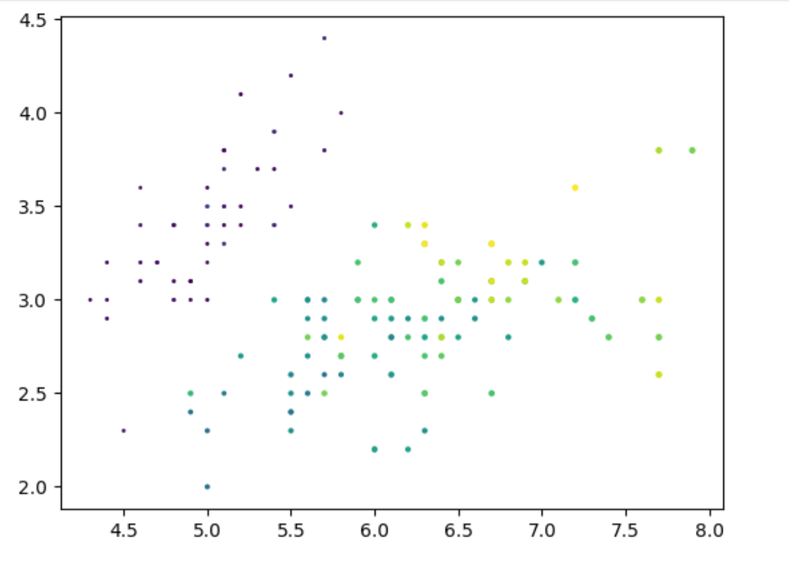
ScatterPlot:
Split Data:
x= df.iloc[:,0:4] y=df.iloc[:,-1]
Distinguish Train and Test Data:
x_train,x_test,y_train,y_test=train_test_split(x,y,test_size=0.1)

Slide 7
Train Dataset Code:
from sklearn.preprocessing import StandardScaler
scaler= StandardScaler()
x_train=scaler.fit_transform(x_train)
x_test=scaler.transform(x_test)
from sklearn.linear_model import LogisticRegression
clf=LogisticRegression()
clf.fit(x_train,y_train)

Slide 8
Engagement data
y_test | y_train | Accuracy
Iris-versicolor | Iris-versicolor
Iris-setosa | Iris-setosa
Iris-setosa | Iris-setosa | 0.93
Iris-virginica | Iris-virginica
Iris-virginica | Iris-virginica
Iris-virginica | Iris-versicolor

Slide 9
93.3%
Accuracy of AI Model
Code:from sklearn.metrics import accuracy_score

Slide 10
Summary
L-BFGS is a powerful optimizer for logistic regression
Scikit-learn makes implementation easy and efficient
Iris dataset provides a clear, interpretable classification example
Visualization helps in understanding model performance

Slide 11
Thank you for your attention!
Feel free to ask questions or request a code demo.
Q&A

